Slide 1
MA1506 Mathematics II
Chapter 5
Matrices and their uses
This chapter consists of two parts

Slide 2
PART ONE
In part one, we shall study
Matrix operations
Some special matrices
Inverse matrix and unique solution of AX=B
Determinant and inverse matrix
Leontief Input-Output model

Slide 3
5.1 What is a Matrix?
rewritten as
2x2 Matrix
2x1 matrix

Slide 4
5.1 What is a Matrix?
3x3 Matrix
m x n Matrix: m rows, n columns
We may write
Entry at i-th row j-th column

Slide 5
5.2 Matrix operations
Matrix addition
Scalar multiplication
Matrix multiplication
Matrix transposition

Slide 6
Matrix Addition
5.2 Matrix operations
m x n matrices
Term by term addition

Slide 7
Scalar multiplication
5.2 Matrix operations
m x n matrix
c
real or complex number
Term by term multiplication

Slide 8
Matrix Multiplication
5.2 Matrix operations
m x n matrix
n x p matrix
m x p matrix
Not term by term but row to column

Slide 9
Example
5.2 Matrix operations
Animation slide

Slide 10
5.2 Matrix operations
In general
Non commutative

Slide 11
Matrix transposition
5.2 Matrix operations
m x n matrix
swap rows with columns
n x m matrix

Slide 12
5.2 Matrix operations

Slide 13
Symmetric matrix
5.3 Special matrices
An n x n matrix is symmetric if

Slide 14
Anti-Symmetric matrix
5.3 Special matrices
An n x n matrix is anti-symmetric or skew symmetric if

Slide 15
Properties of Symmetric matrices
5.3 Special matrices
If A is symmetric and B is any square matrix
Hence
is symmetric
The above property will be used in T8 Q4
Hence
is symmetric

Slide 16
Properties of anti-Symmetric matrices
5.3 Special matrices
If A is anti-symmetric and B is any square matrix
Hence
is anti-symmetric
The above property will be used in T8 Q4
Hence
is anti-symmetric

Slide 17
Identity matrix
5.3 Special matrices
n x n identity matrix
sometimes denoted by I_{n}

Slide 18
Vectors as special matrices
5.3 Special matrices
Matrices containing only one column are often
called column vectors or vectors
Matrices containing only one row are often
called row vectors or vectors

Slide 19



Vectors
5.3 Special matrices
(0,1)
=
=
(1,0)
(0,0,1)
(1,0,0)
(0,1,0)
=
=
=

Slide 20
5.3 Special matrices
=
=

Slide 21

Rotation
5.3 Special matrices
Rotation (anti-clockwise)
through angle
Let

Slide 22

Rotation
5.3 Special matrices
Rotation (anti-clockwise)
through angle
R transforms

Slide 23
5.3 Special matrices

Slide 24
Orthogonal matrix
5.3 Special matrices
An n x n matrix, B is orthogonal if
is orthogonal
Check

Slide 25
An n × n matrix A is orthogonal iff its columns are perpendicular unit
vectors.
An n × n matrix A is orthogonal iff its rows are perpendicular unit
vectors.

Slide 26
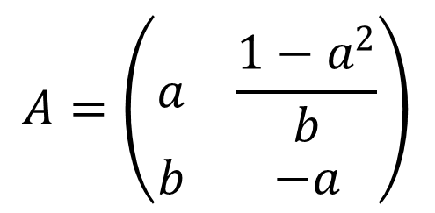
Involutory matrix ( a matrix that is its own inverse)
$$A=\left(\begin{matrix}a & \frac{1−a^{2}}{b} \\ b & −a\end{matrix}\right)$$
Example
or
Then

Slide 27
Shear angle and parallel to x-axis
5.3 Special matrices
Let S=
Then
So

Slide 28
5.3 Special matrices
multiplication
multiplication
becomes
,turn angle
clockwise,
measure
from

Slide 29
5.3 Special matrices
We may say that S maps
to
maps
to
S maps
(S transforms)

Slide 30
5.3 Special matrices
θ
or

Slide 31
5.3 Special matrices
θ
or

Slide 32
Question 7 (a) [5 marks] (2007 Exam )
In two dimensions, we perform a shear [shearing angle 45 degrees] by means of forces parallel to an axis which makes an angle of 30 degrees with respect to the positive x-axis. Find the final location of the point which was originally at (x, y) coordinates (0, 1).
Rotate
Shear
parallel to x axis
Rotate

Slide 33
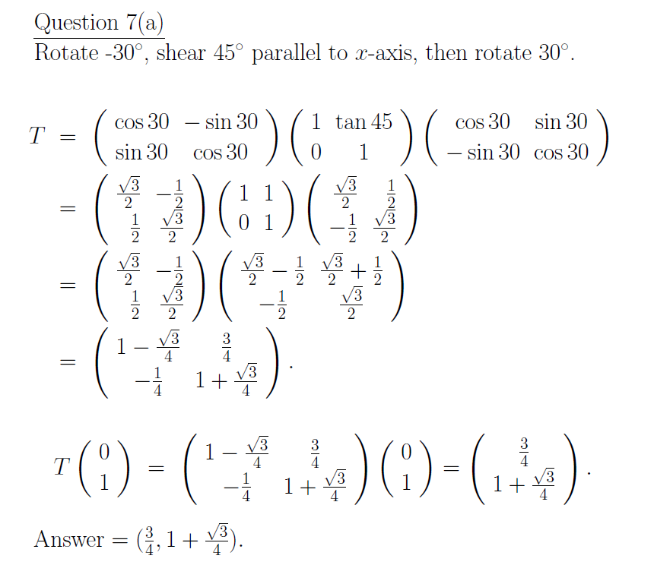

Slide 34
Summary
We have learnt
5.3 Special matrices
symmetric matrix A
anti symmetric matrix A
identity matrix
orthogonal matrix B
Involutory matrix A
vector
shear matrix
rotation matrix

Slide 35
5.4 Inverse matrix and unique solution
.
Let
A=
be an
matrix
Then an
matrix C is said to be
an inverse matrix of A if
AC=CA=
identity matrix

Slide 36
5.4 Inverse matrix and unique solution
The inverse matrix of A is denoted by
WARNING: We only define inverse for
matrices, i.e. square matrices.
Let A=
be an
matrix

Slide 37
5.4 Inverse matrix and unique solution
X=
B=
Consider a linear system
AX=B
i.e.,
=

Slide 38
5.4 Inverse matrix and unique solution
which is equivalent to

Slide 39
5.4 Inverse matrix and unique solution
Theorem 1
The linear system of equations AX=B
has a unique solution if and only if A has an inverse
Proof omitted
Remark: B can be any n-dim vector
How to find
if
exists?
We can perform elementary row operations to A to get
See Appendix

Slide 40
5.5 Determinants and inverse
In this section, we introduce determinants, which help us to determine whether an
matrix has an inverse or not.
Consider
=
Then
(1)
(2)

Slide 41
5.5 Determinants and inverse
Hence
get
Similarly
Therefore the linear system of equations
has unique solution if and only if

Slide 42
5.5 Determinants and inverse
We define the determinant of
to be
We write
det
=
or
=

Slide 43
5.5 Determinants and inverse
Let
A=
Then we define the determinant of A,
(denoted by det(A) or )
to be det(A)
=
How to get this? see next slide

Slide 44
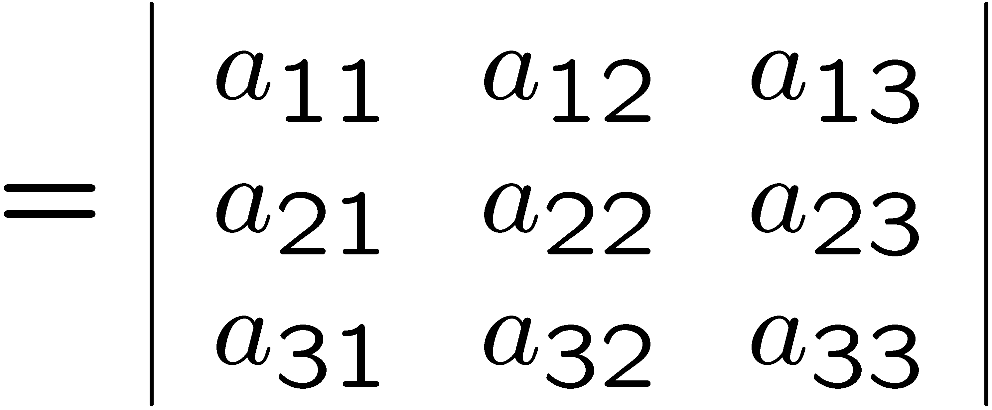
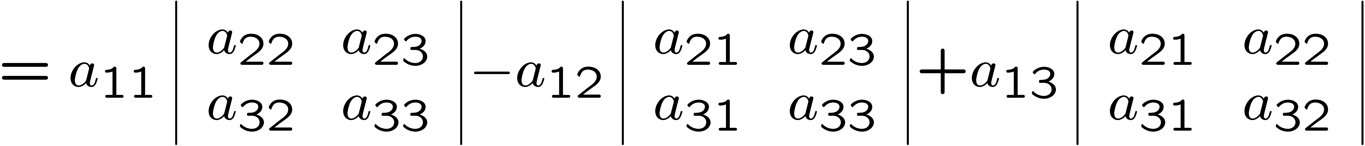
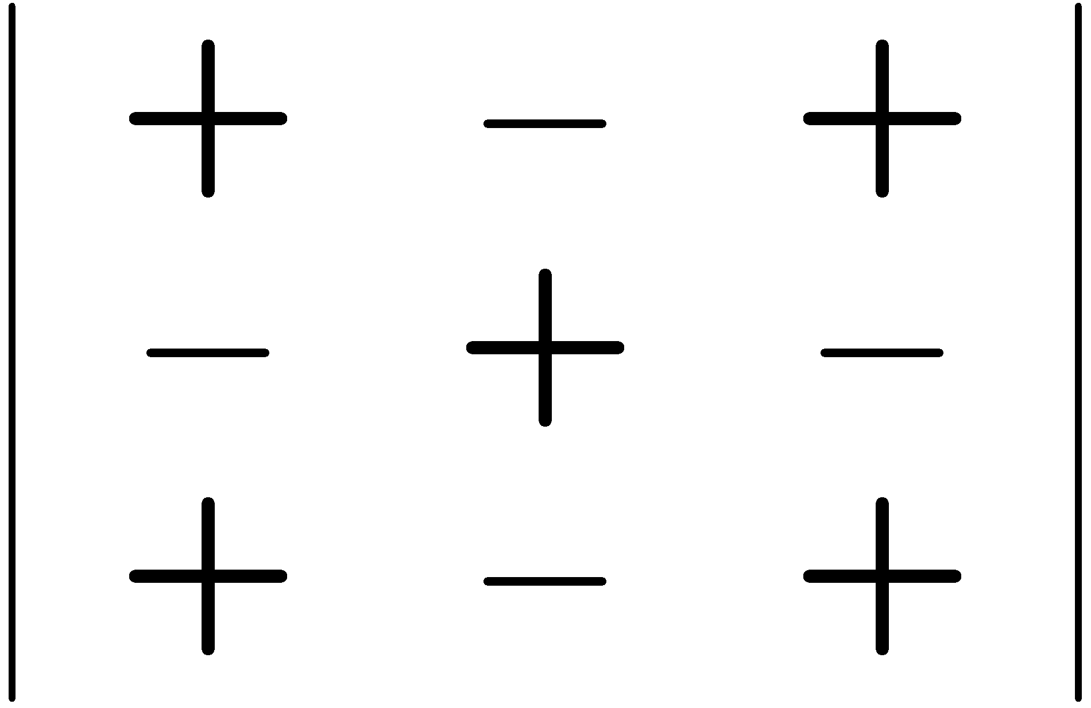
5.5 Determinants and inverse
Animation slide
det A
cofactor
cofactor
cofactor
called cofactor expansion

Slide 45
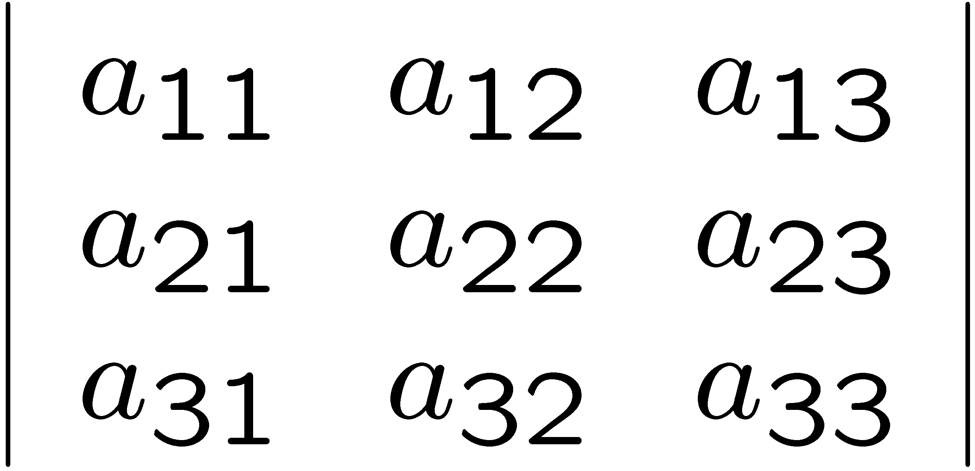
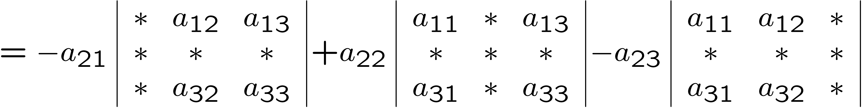
5.5 Determinants and inverse
Cofactor expansion can be done about any row or column
2x2 matrix

Slide 46
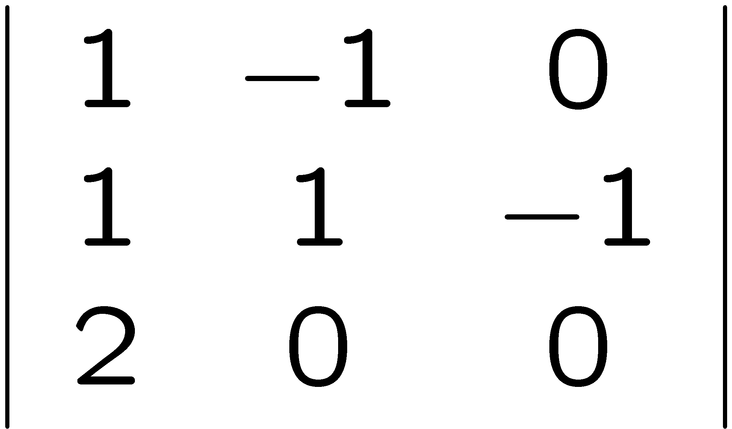
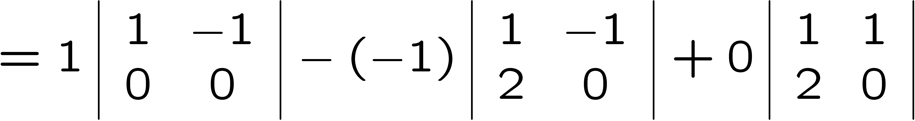

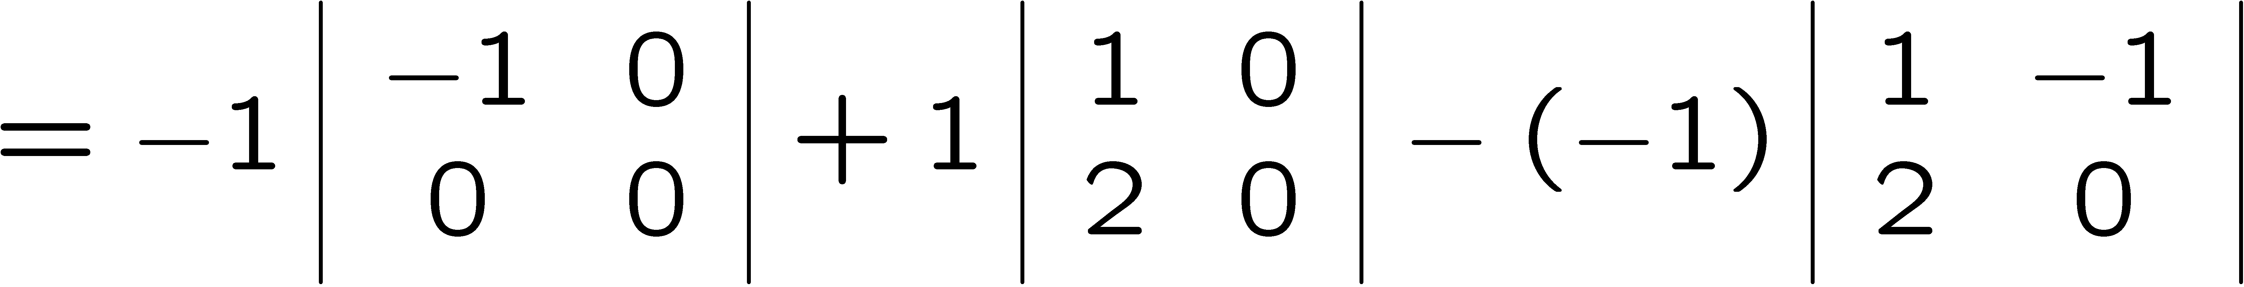

Examples
5.5 Determinants and inverse
Animation slide

Slide 47
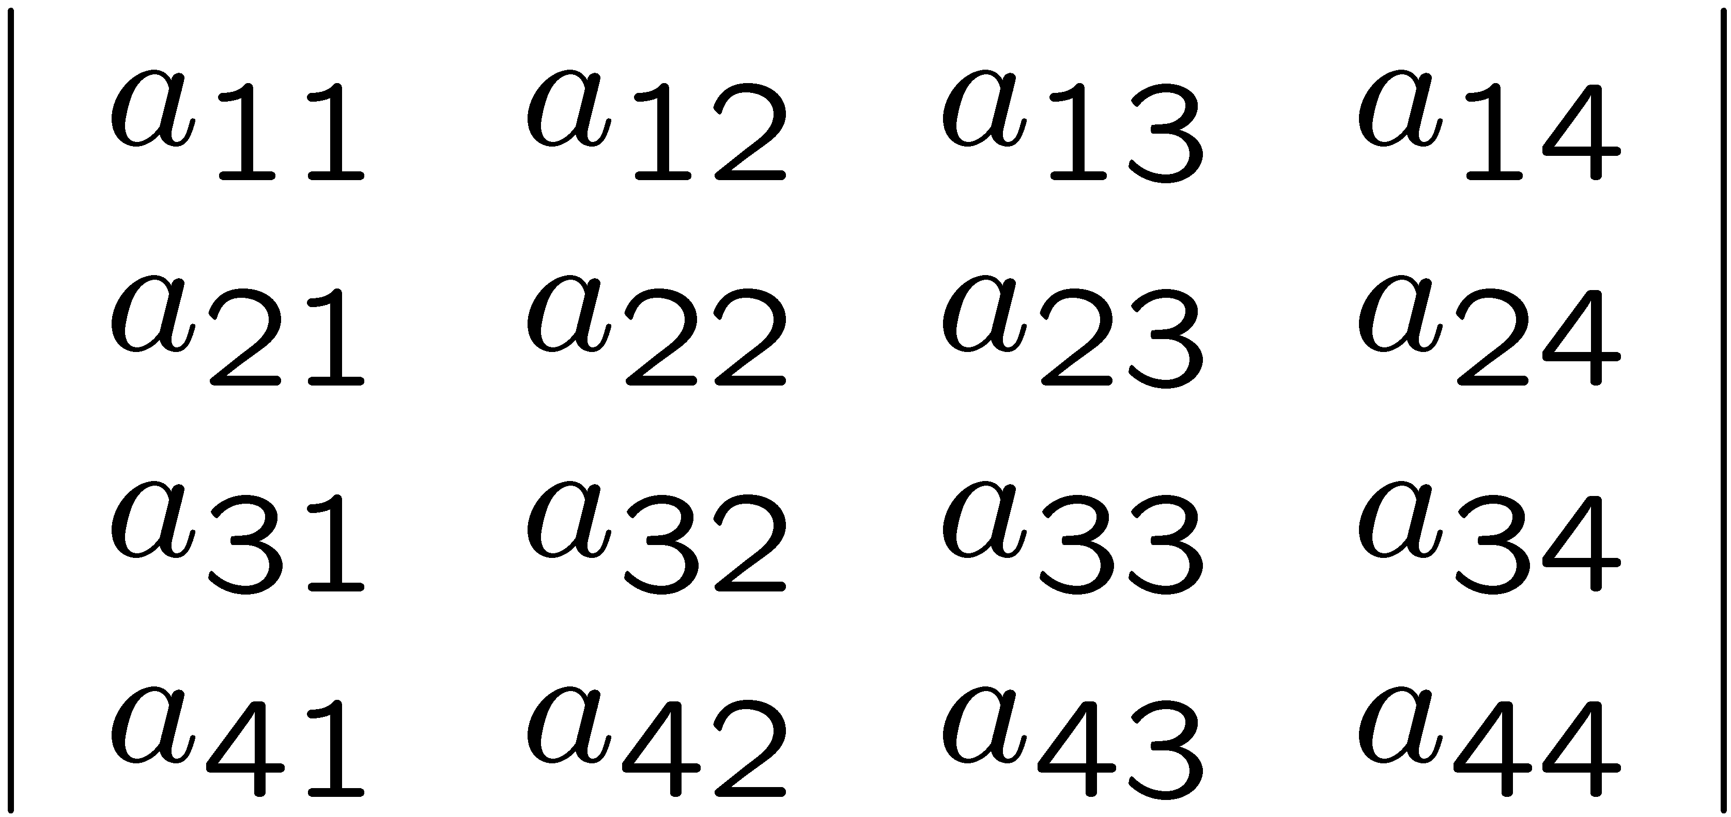
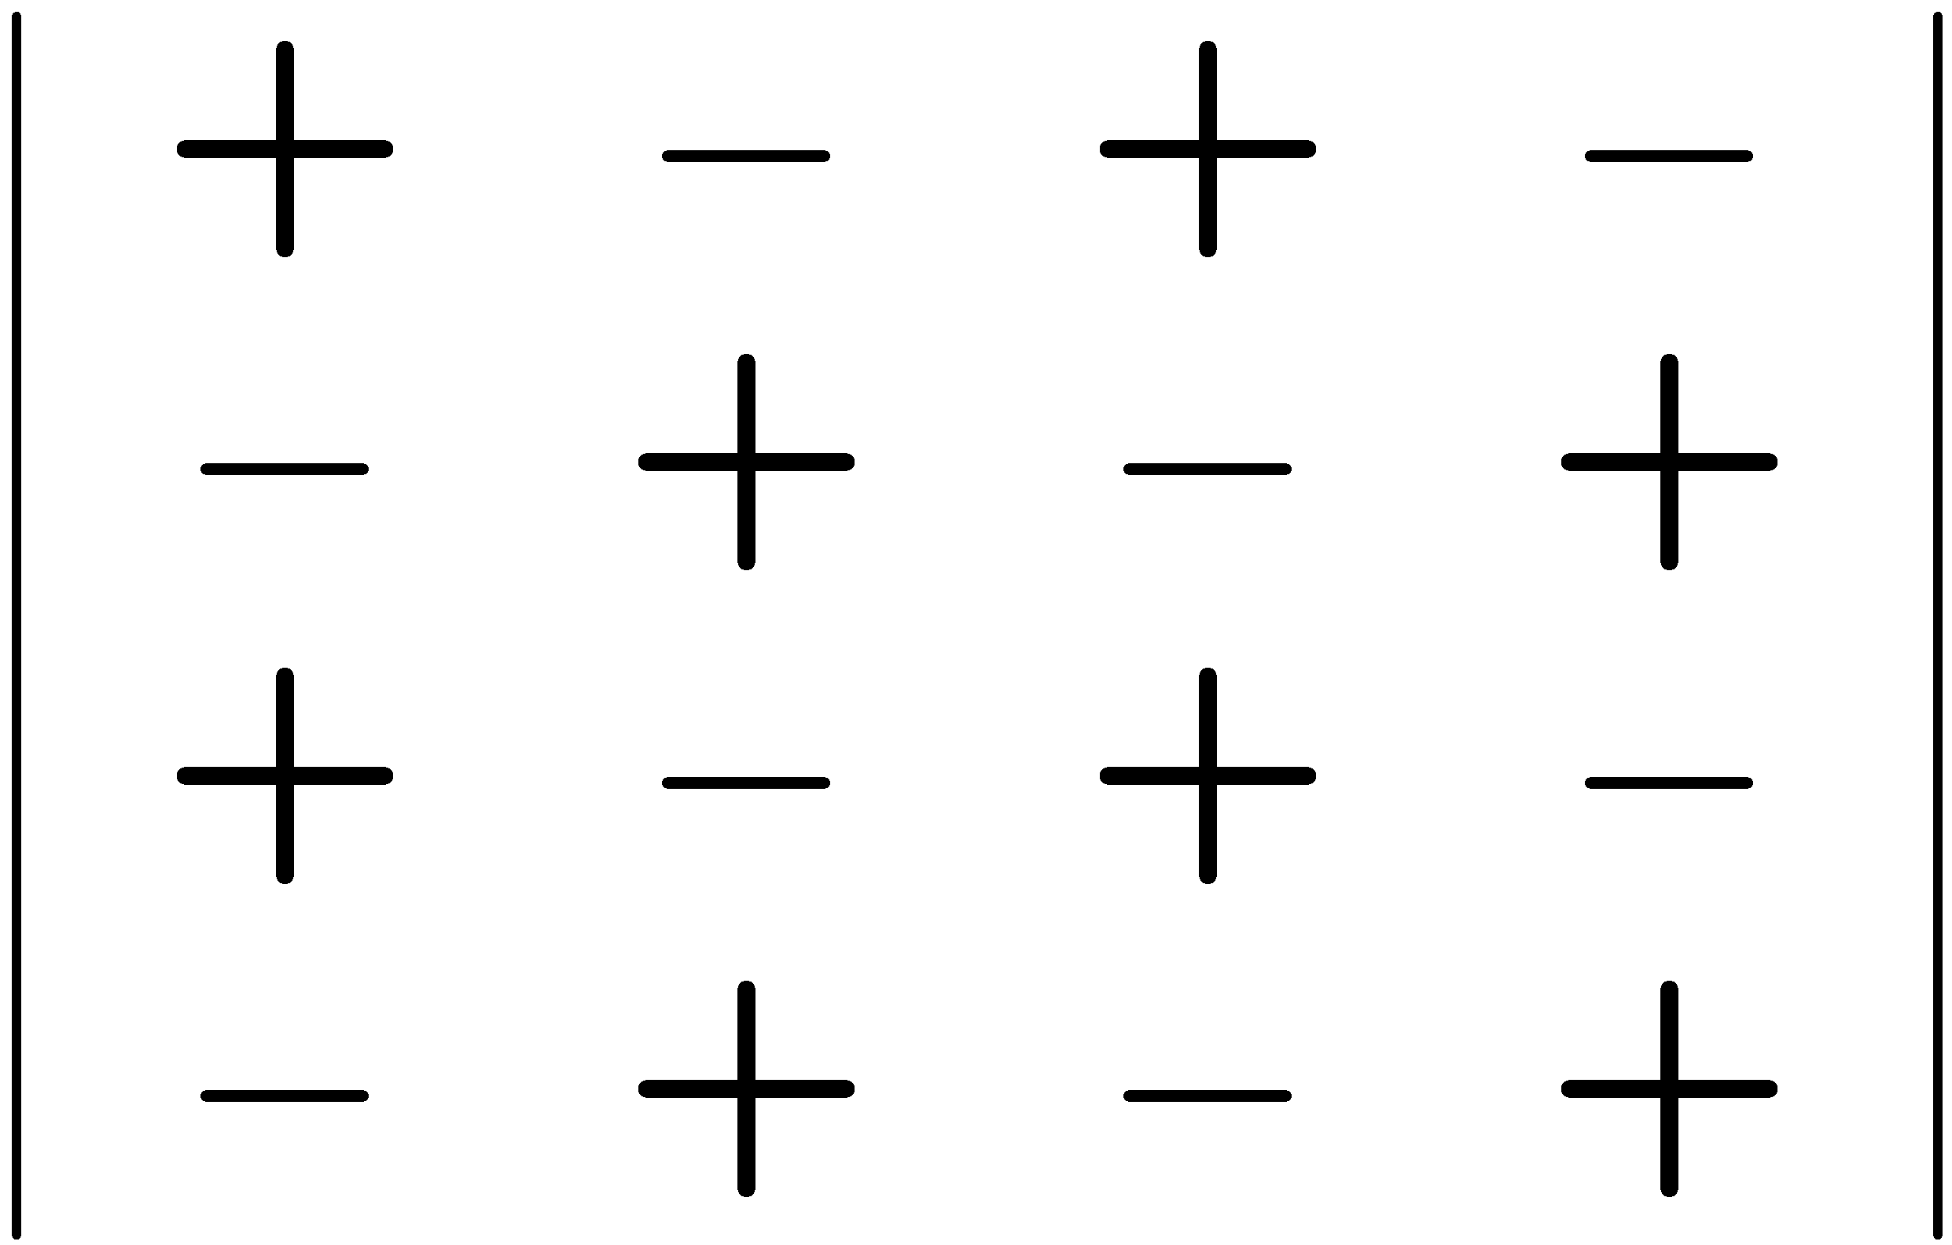
5.5 Determinants and inverse
Cofactor expansion can be used for any
n x n determinant

Slide 48
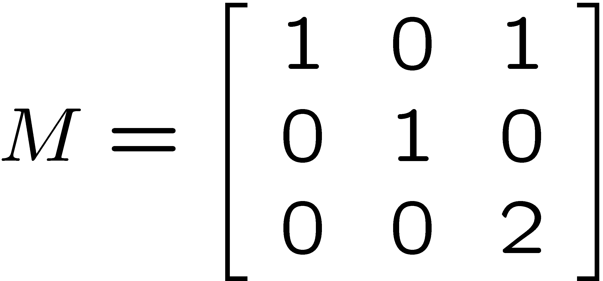
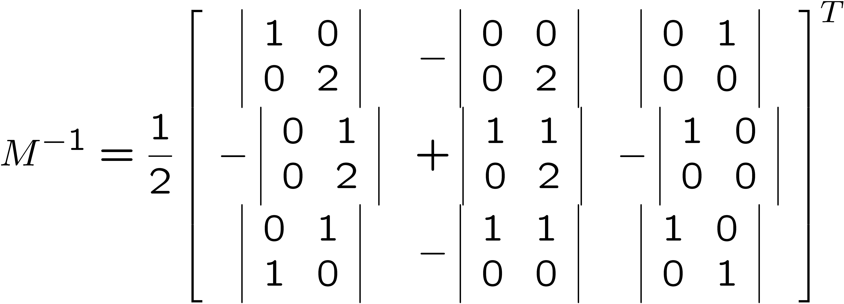
2nd method (cofactor expansion) finding Inverse
Work out the matrix of cofactor of each entry
Take transpose
Divide by determinant

Slide 49
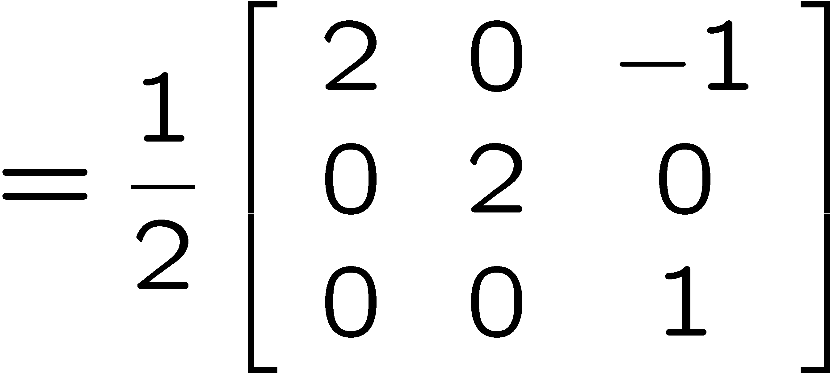
5.5 Determinants and inverse

Slide 50
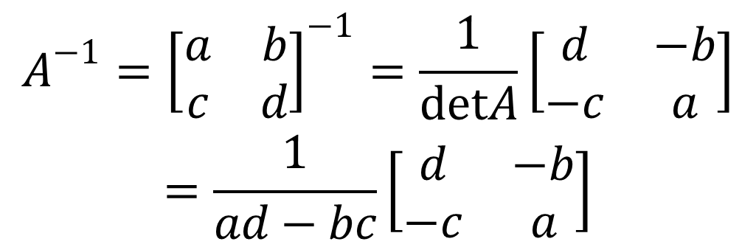
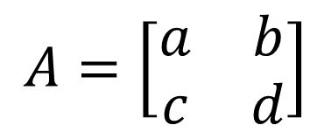
5.5 Determinants and inverse
Inverse of 2x2 matrix
Let
$$A=\left[\begin{matrix}a & b \\ c & d\end{matrix}\right]$$
Then
$$\begin{matrix}A^{−1}={\left[\begin{matrix}a & b \\ c & d\end{matrix}\right]}^{−1}=\frac{1}{detA}\left[\begin{matrix}d & −b \\ −c & a\end{matrix}\right] \\ =\frac{1}{ad−bc}\left[\begin{matrix}d & −b \\ −c & a\end{matrix}\right]\end{matrix}$$

Slide 51
Important Properties of Determinants
5.5 Determinants and inverse
size of M

Slide 52
5.5 Determinants and inverse
If A is upper (lower) triangular, then
det(A)=product of all diagonal entries of A

Slide 53
Theorem 2
5.5 Determinants and inverse
An nxn matrix A has an inverse if and only if det(A)≠0
Proof omitted
A has an inverse
B does not have an inverse

Slide 54
Theorem 3
5.5 Determinants and inverse
Let A be an nxn matrix. Then AX=B has a unique solution
if and only if det(A)≠0
Proof omitted
Remark: B can be any n-dim vector
has a unique solution
since

Slide 55
Theorem 4
5.5 Determinants and inverse
Let A be nxn matrix. Then AX=0
has nontrivial (nonzero) solutions
if and only if det(A)= 0.
Zero vector
Proof omitted
Note that A0=0.
Hence zero vector 0= is always a solution of AX=0

Slide 56
5.5 Determinants and inverse
has a unique solution
Then the unique solution should be

Slide 57
5.5 Determinants and inverse
Remark 1: AX=0 has nonzero solutions
iff AX=0 has infinitely many
solutions.
Proof:
Suppose AX=0 has nonzero soln u. Then Au=0.
Let c be any real number. Then
A(cu)=cAu=c0=0
Hence cu again is a soln.
Here c is any real number.
So we have infinitely many soln
Now consider the converse.
If AX=0 has infinitely many solns,
then AX=0 certainly has nonzero soln

Slide 58
5.5 Determinants and inverse
Remark 2: AX=0 has either unique solution
(detA≠0)
or infinitely many solutions
(detA=0)
Remark 3:If detA =0 , then AX=B, where B ≠0,
has two cases: infinitely many solns or no
solns

Slide 59
5.6 Leontief Input-Output Model
we use this model to analyze economics of
interdependent sectors
Example ---Oil and Transportation industries
Total output $y of Transportation industry requires
(i) $0.50y gasoline from the oil industry
(ii) $0.20y transportation of equipment from the
transportation industry

Slide 60
5.6 Leontief Input-Output Model
(2) The total output $x of Oil industry requires
(i) $0.12x transportation of gasoline from the
transportation industry
(ii) $0.32x oil-based fuels for processing from
the oil industry
We will look at a single oil company and a single
transportation company as a closed system

Slide 61
5.6 Leontief Input-Output Model
(3)Suppose that the demand from the outside sector of the economy (all consumers outside of oil and transportation) is:
$15 billion for oil
$1.2 billion for transportation

Slide 62
5.6 Leontief Input-Output Model
$x b = the total output from oil company=oil demand
$y b = the total output from transportation company
=transportation demand
.

Slide 63
Setting up the demand equations
5.6 Leontief Input-Output Model
The total output of each company will equal the sum of the internal and external demands:
Expressed as a matrix equation:

Slide 64
Solving the demand equations
5.6 Leontief Input-Output Model
Solve for X:
In our example:
called technology matrix

Slide 65
5.6 Leontief Input-Output Model

Slide 66
The solution
5.6 Leontief Input-Output Model
Putting it all together:
In order to meet the demand the companies need to produce
$26.0 billion of oil
$5.4 billion of transportation

Slide 67
5.6 Leontief Input-Output Model
Can you solve the above without using matrices ?
Sure, you can
However if it involves many variables, then solving
it by matrices is easier.
End of part I

Slide 68
Chapter 5
PART TWO

Slide 69
In part II, we shall study
Eigenvalues and eigenvectors---very important
concepts
Diagonalization of matrix
Weather forecasting model
Trace of a matrix

Slide 70
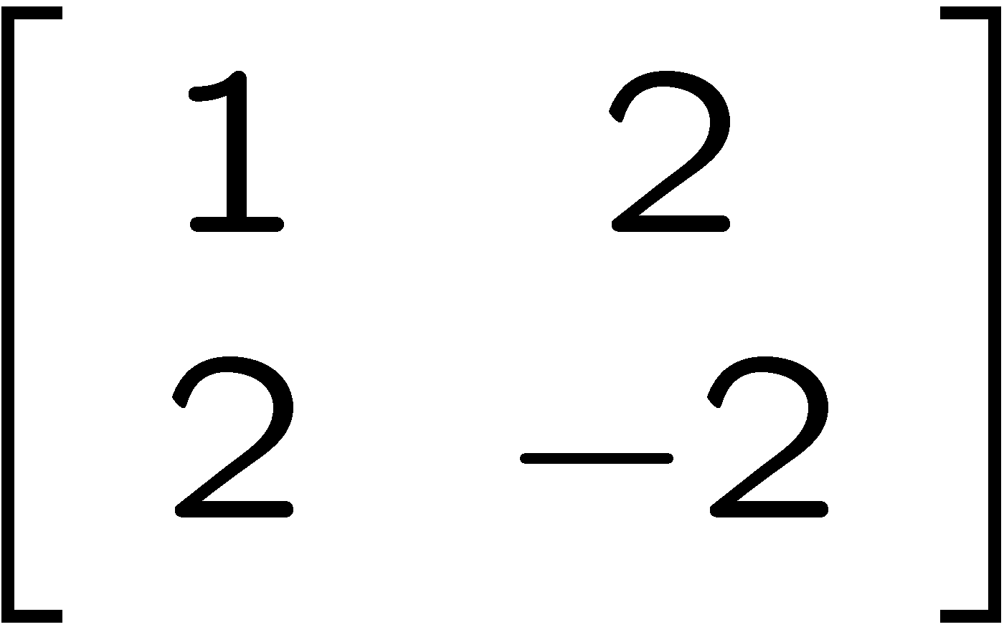
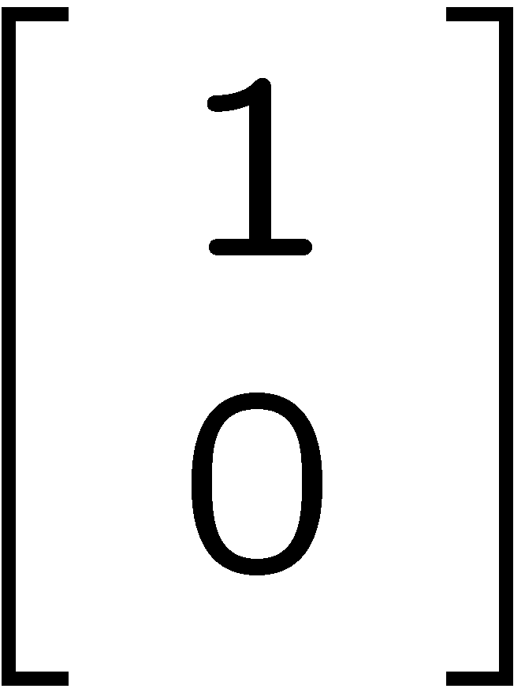


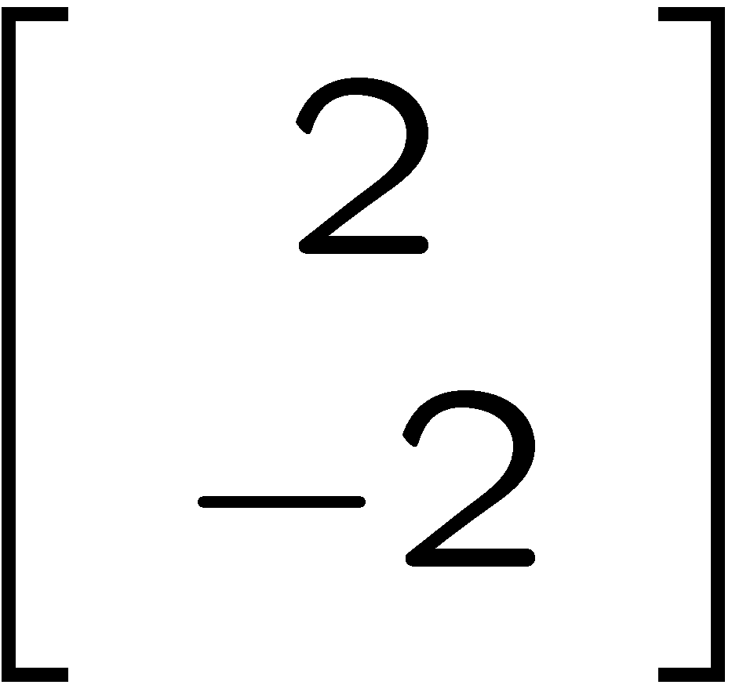
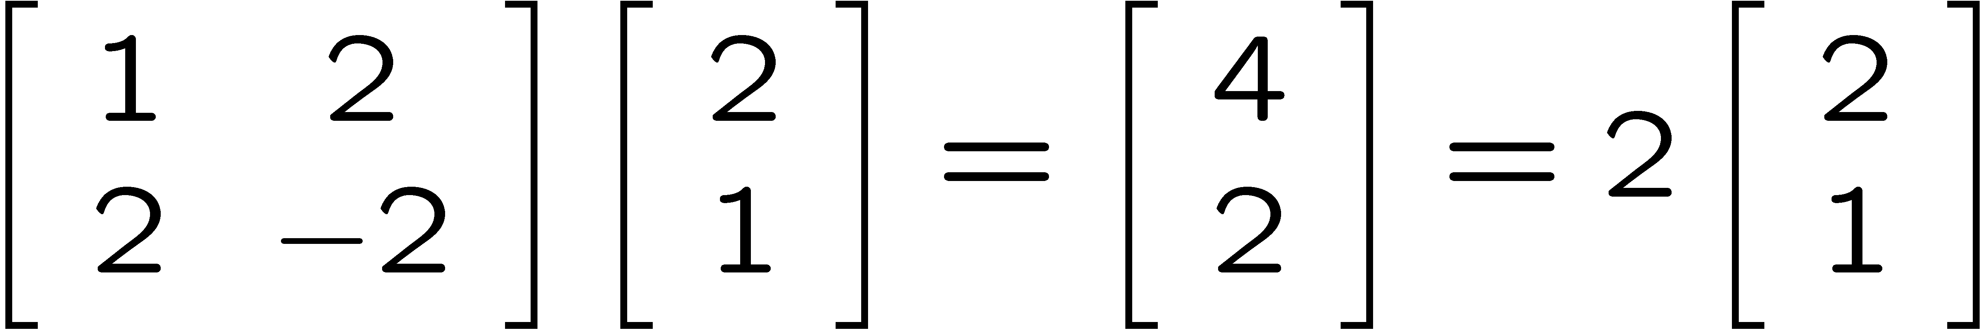
5.7 Eigenvalues and eigenvectors
Consider
Vectors are in different directions
=
=
Vectors are in different directions
Vectors are in same direction
parallel

Slide 71
Rewrite
5.7 Eigenvalues and eigenvectors
Let T=
Then
T
=
T
=
T
multiplying
by
is the same as multiplying
by 2
So we are interested in the last case

Slide 72
Eigenvector
T
5.7 Eigenvalues and eigenvectors
is nxn matrix
suppose
We may use
or
eigenvalue eigenvector
Matrix multiplication
is the same as scalar multiplication
which is much easier
After multiplication (transformation),
does not change the direction

Slide 73
How to find Eigenvalues and Eigenvectors
5.7 Eigenvalues and eigenvectors
How to find eigenvalue λ and eigenvector
First note that
Hence zero vector 0 is always an eigenvector
We want to find nonzero eigenvectors

Slide 74
5.7 Eigenvalues and eigenvectors
How to find nonzero eigenvectors
First note that
T-λ is
not meaningful
we want nonzero vector
By Thm 4 in section 5.5, we have
Hence we can find nonzero eigenvalues
using above equation

Slide 75
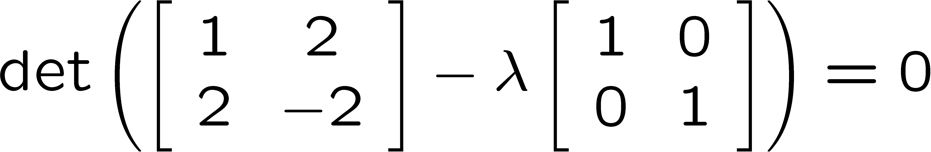
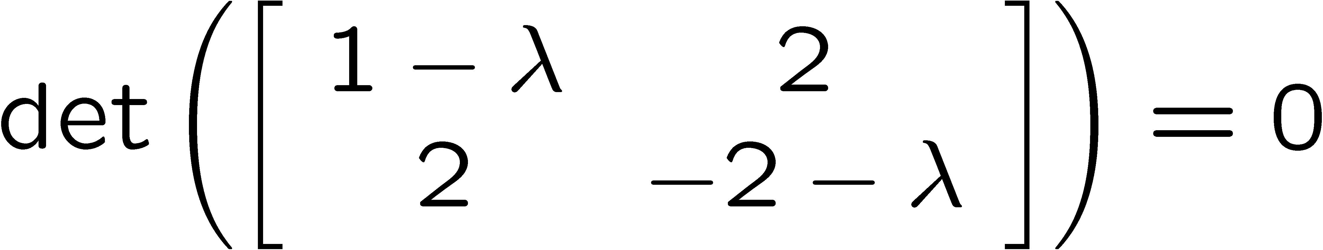
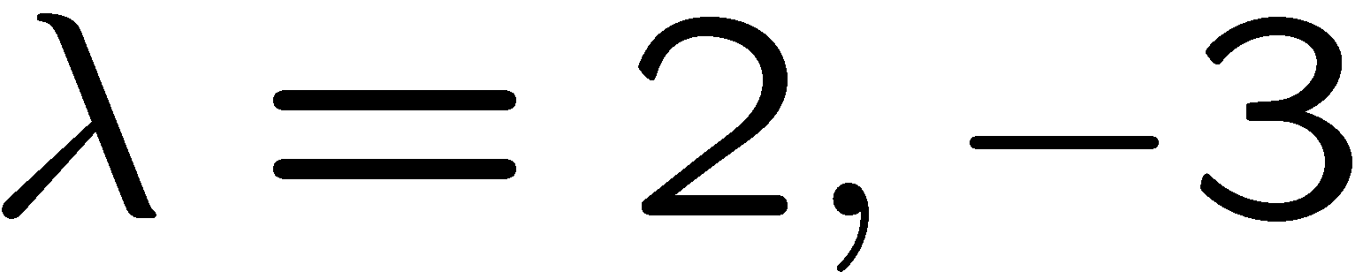
Example
5.7 Eigenvalues and eigenvectors
Find eigenvalues of

Slide 76
Cont.
5.7 Eigenvalues and eigenvectors
Now we shall find eigenvector
associated to eigenvalue λ=2

Slide 77
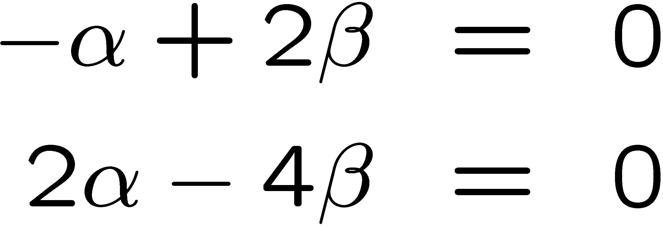
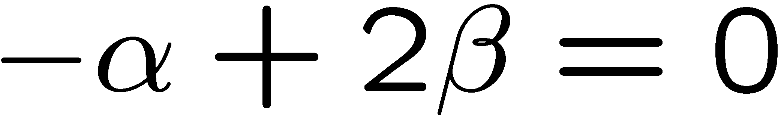
Cont.
5.7 Eigenvalues and eigenvectors
two equations same
1 equation 2 unknowns
They are many solutions, i.e. many eiqenvectors

Slide 78
Cont.
5.7 Eigenvalues and eigenvectors
Eigenvectors associated to eigenvalue 2 are of the form
All eigenvectors are
parallel i.e. all are
linearly dependent
=
α≠0
choose
get eigenvector
need only to choose one

Slide 79
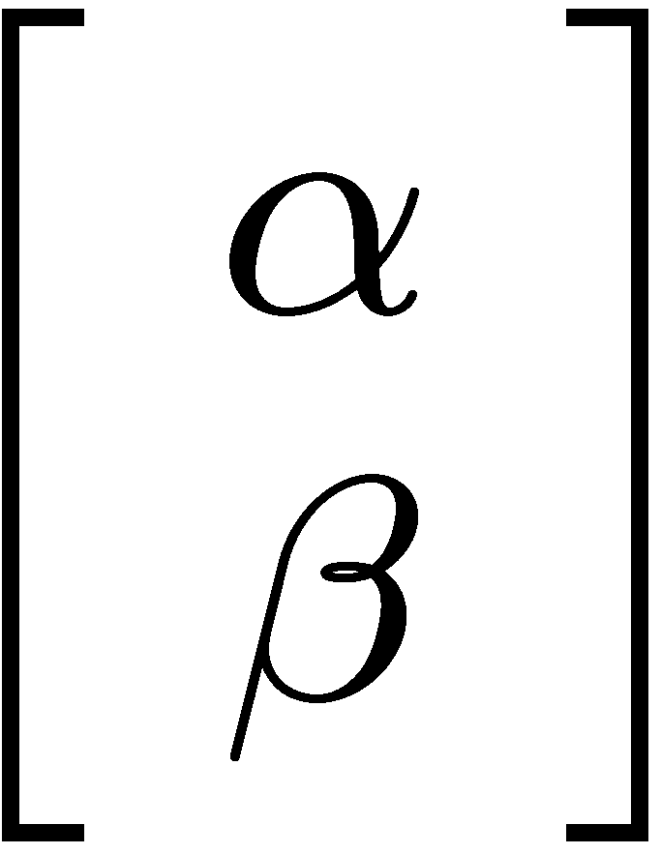
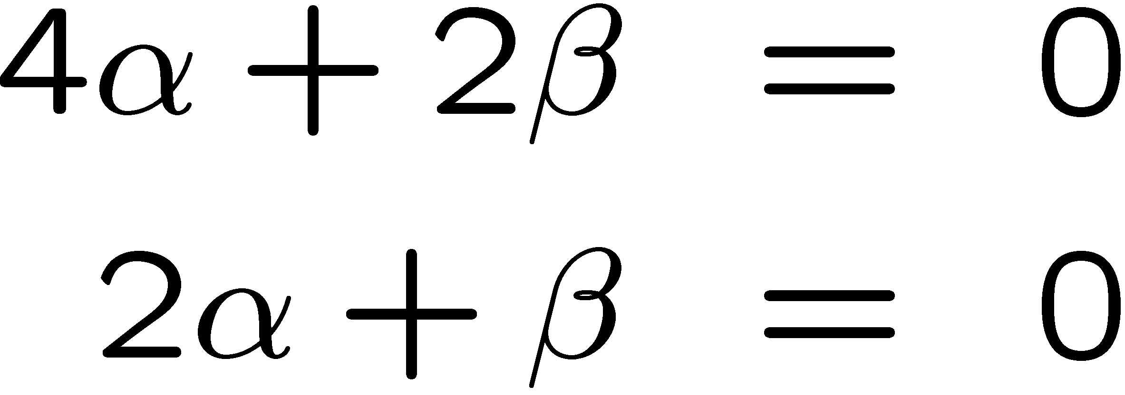
Cont.
5.7 Eigenvalues and eigenvectors
Now find
eigenvector associated to λ= -3
two eqs same

Slide 80
Cont.
5.7 Eigenvalues and eigenvectors
eigenvectors associated to λ=-3 is of the form
α≠0
choose
get eigenvector
need only to choose one

Slide 81
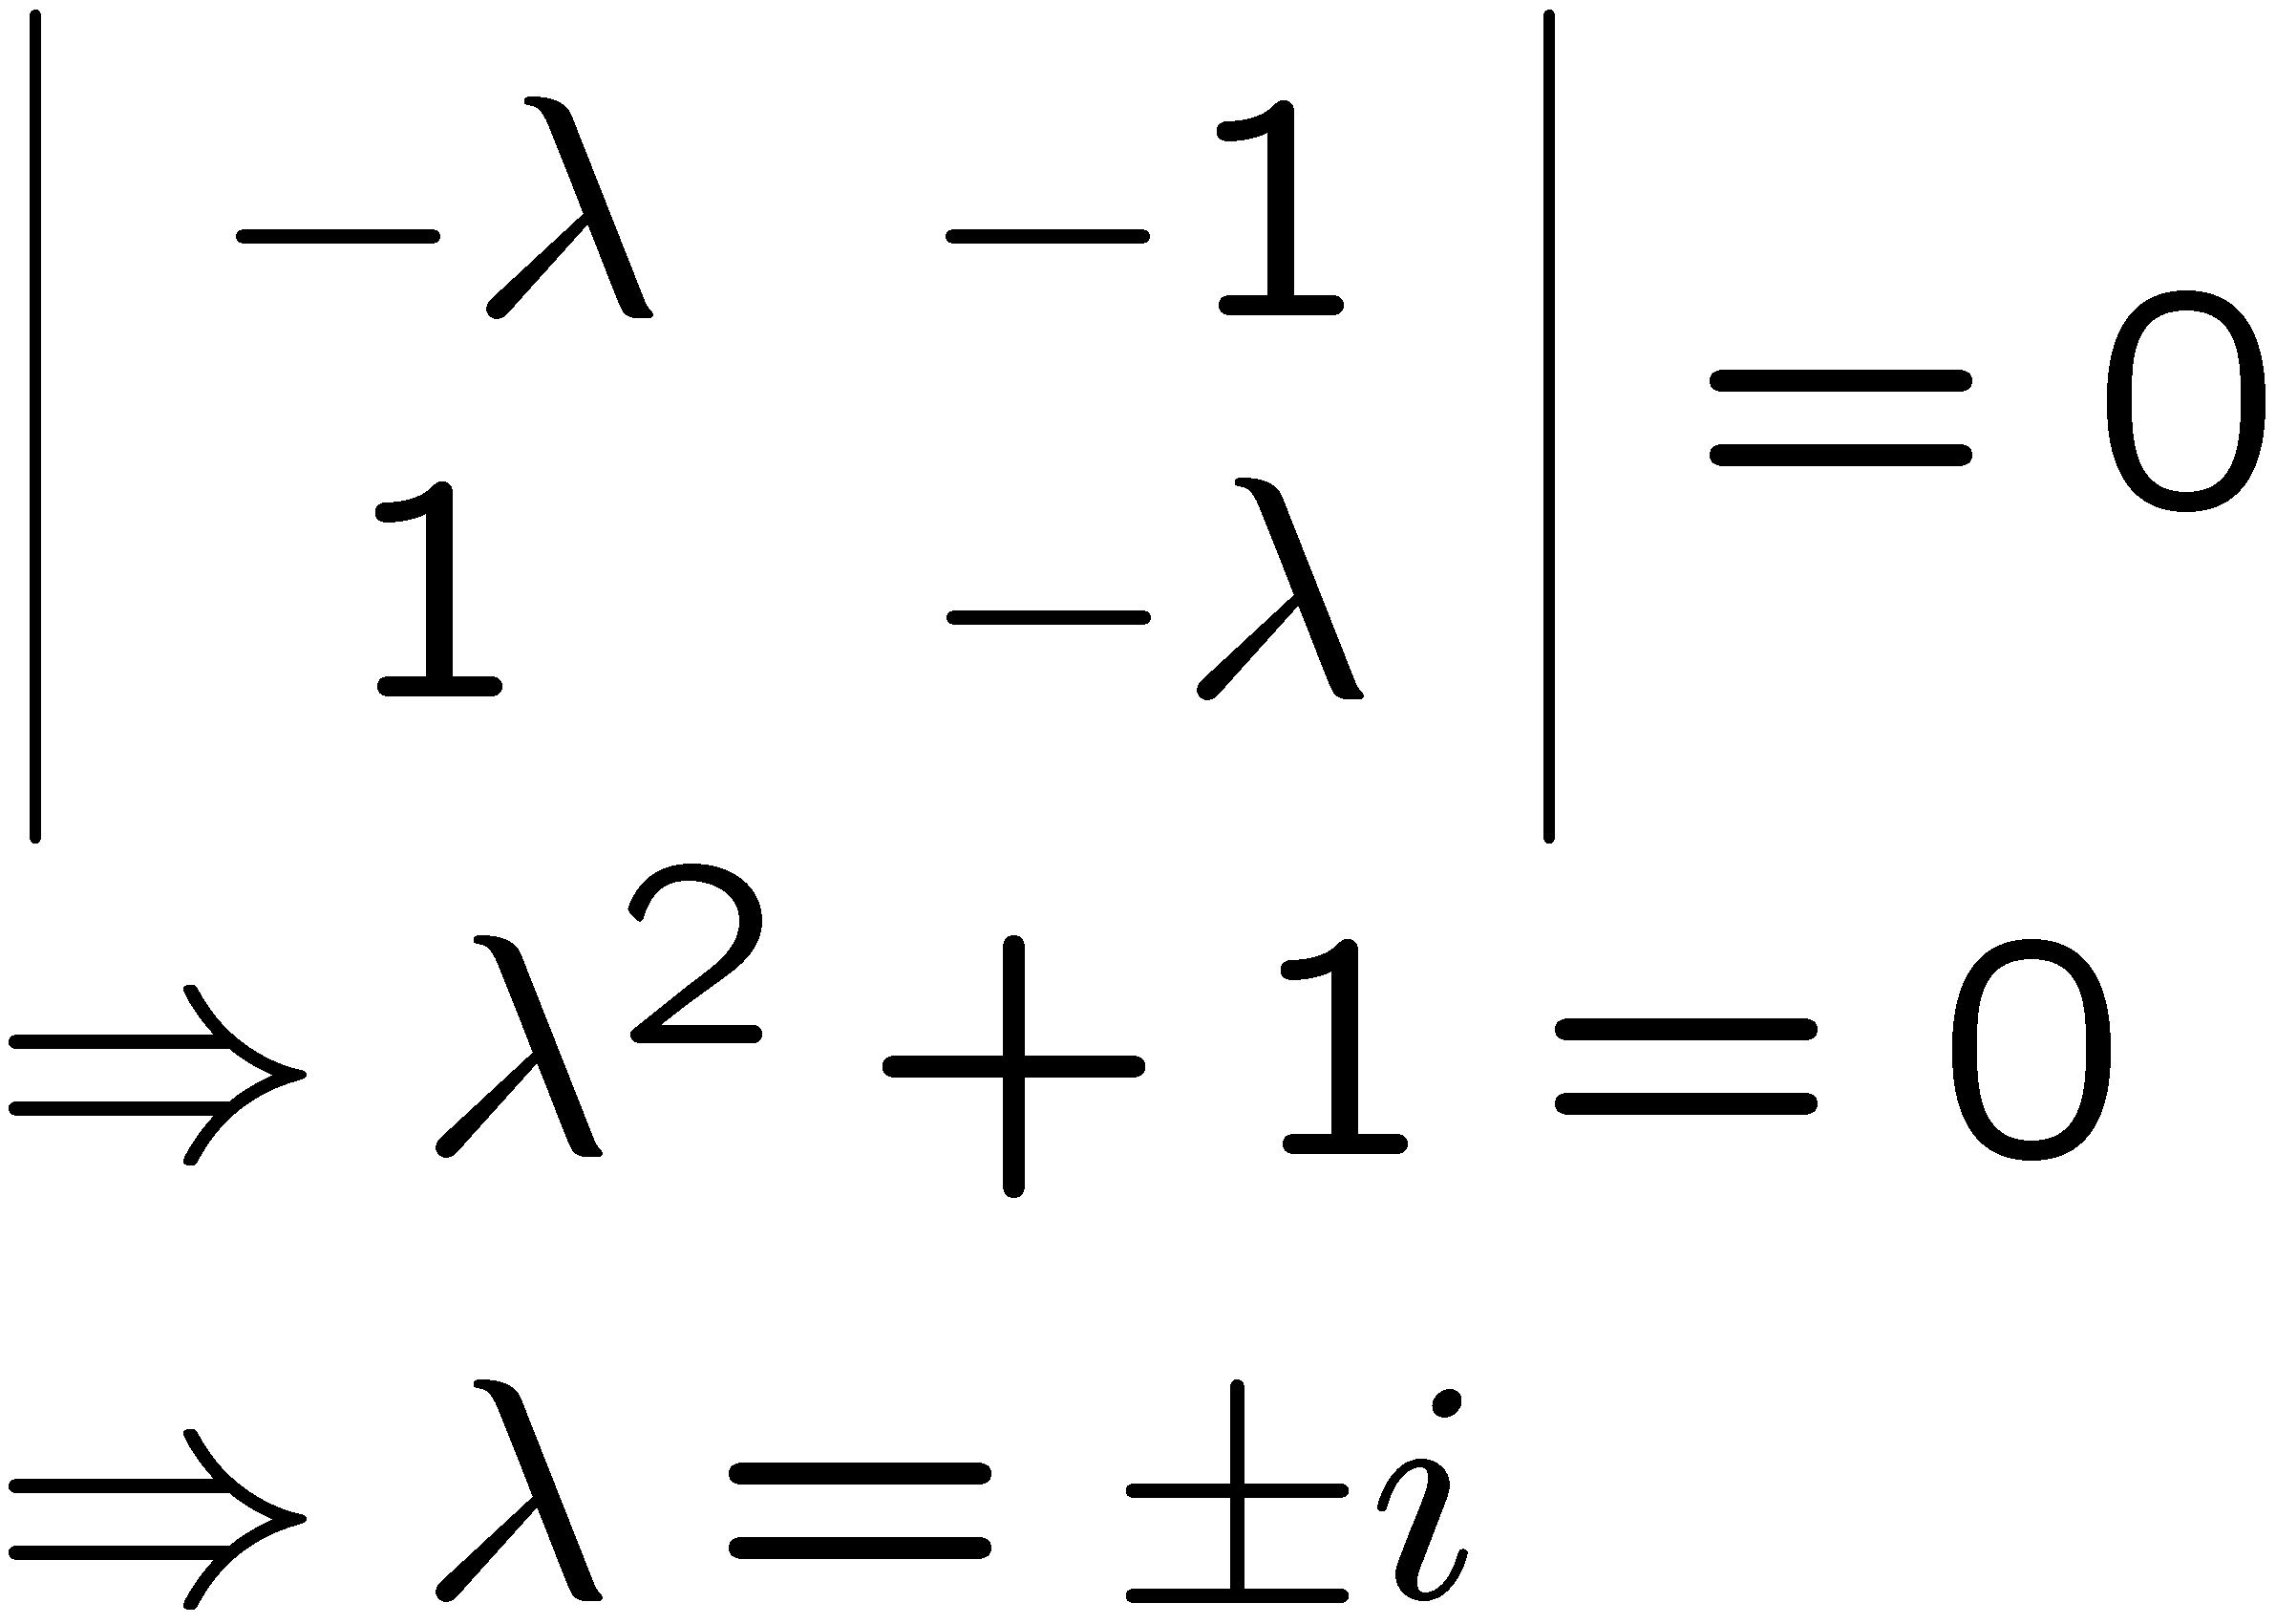
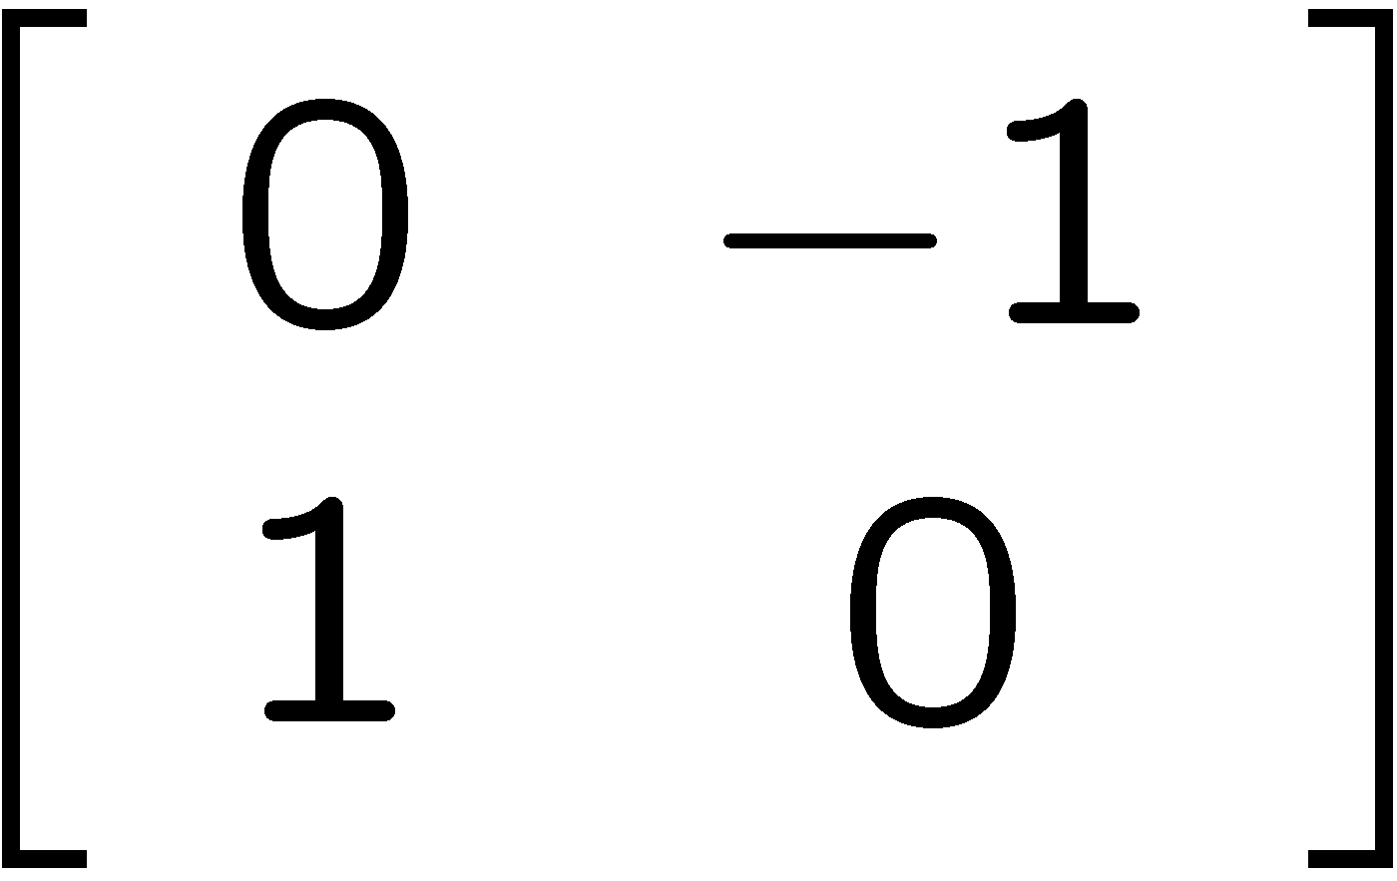
Example
5.7 Eigenvalues and eigenvectors
T=
consider
Two eqs same

Slide 82
Cont.
5.7 Eigenvalues and eigenvectors
Two eqs same
use
eigenvector
choose
get complex eigenvector

Slide 83
cont.
5.7 Eigenvalues and eigenvectors
Now consider second eigenvalue
get
Two eqs same
use
get eigenvector
get complex eigenvector
choose

Slide 84
cont.
5.7 Eigenvalues and eigenvectors
Recall
So the matrix we just mentioned
represents rotation through 90 degrees
are its eigenvectors which are complex
When rotating through 90 degrees, every real vector should change direction, so
has NO real eigenvector

Slide 85
5.8 Diagonalization
5.8 Diagonalization
We say a matrix A is diagonalizable if
Diagonal matrix of eigenvalues
Matrix of eigenvectors
When a given matrix A can be diagonalized ?
ANS: If A is nxn matrix , and it has n non parallel eigenvectors, then A can be diagonalized.

Slide 86
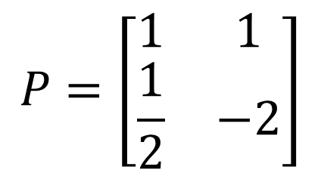

Example
5.8 Diagonalization
From the first example in section 5.7, we know
has eigenvalues 2 and -3
and corresponding eigenvectors
=
=
Then
$$P=\left[\begin{matrix}1 & 1 \\ \frac{1}{2} & −2\end{matrix}\right]$$
$$D=$$

Slide 87
5.8 Diagonalization
Next we can verify that
=

Slide 88
Example
5.8 Diagonalization
has only one eigenvalue since
It has only one eigenvector
Not possible to diagonalize

Slide 89
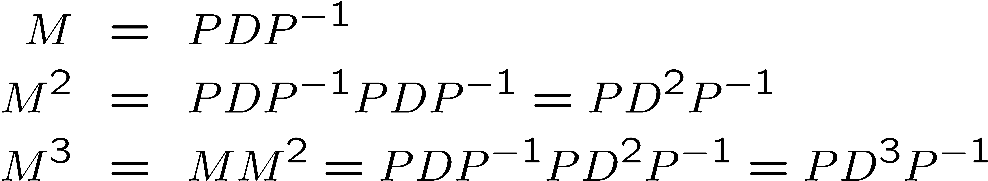
5.8 Diagonalization
Finding

Slide 90
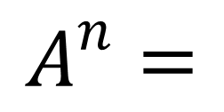
5.8 Diagonalization
Some special cases
Not used this method
(1)
(2)
Involutory matrix A
Then
$$A^{n}=$$

Slide 91
5.9 Model weather forecasting
Today | Tomorrow | Probability
Rainy | Rainy
 | Sunny
Sunny | Rainy
 | Sunny
60%
40%
30%
70%
We can write the above information in
the following matrix form

Slide 92
5..9 Model weather forecasting
Next:
R
Current : R S
S
called transition matrix
columns add to 1

Slide 93

5..9 Model weather forecasting
Today is sunny, will it be rainy 2 days later?
0.7
S
0.49
0.21
0.7
S
0.39
0.61
R
0.3
S
0.4
S
0.12
0.18
0.3
R
0.6
R

Slide 94
5..9 Model weather forecasting
Observe that
In fact

Slide 95
5..9 Model weather forecasting
Summary of the previous slide
Today is rainy, will it be sunny 2 days later?
Today is sunny, will it be sunny 2 days later?
Probability=0.52
Probability=0.61
Today is rainy, will it be rainy 2 days later?
Today is sunny, will it be rainy 2 days later?
Probability=0.48
Probability=0.39

Slide 96
5..9 Model weather forecasting
Today is Rainy, will it be rainy 4 days later?
The probability that if today is rainy, it will be rainy
4 days later is
0.4332

Slide 97
5..9 Model weather forecasting
Today is Rainy, will it be rainy 30 days later?
Find
Should use
Eigenvalues of
are
Corresponding eigenvectors are

Slide 98
5..9 Model weather forecasting
When use this method?
suggest: n>4

Slide 99
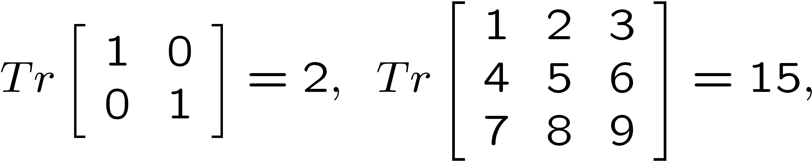
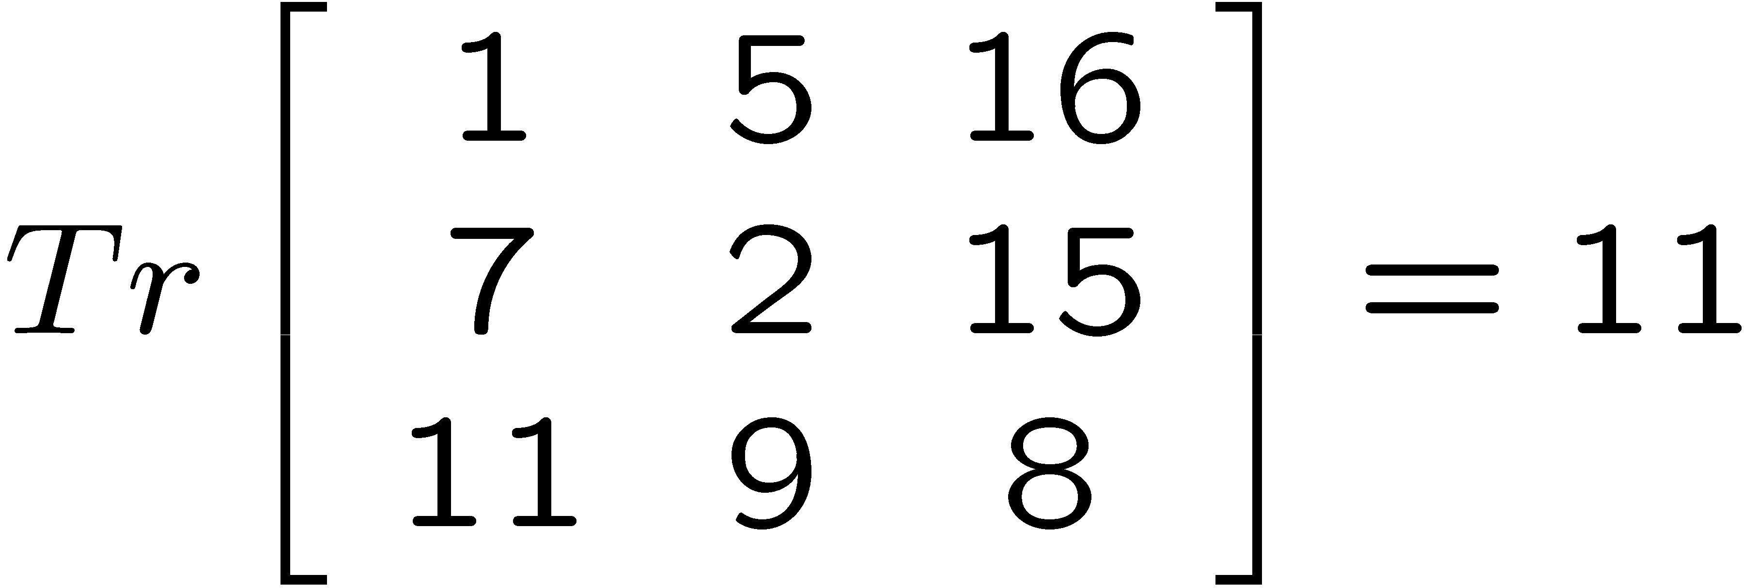
5.10 Trace of a Matrix
Let M be a square matrix.
The trace of M , denoted Tr (M), is the sum of the diagonal entries

Slide 100
5.10 Trace of a Matrix
Given matrix
For a diagonalizable matrix M,
Tr(M) = Tr(D) =sum of its eigenvalues.

Slide 101
5.10 Trace of a Matrix
Example 1
Tr(M) = Tr(D) =sum of its eigenvalues.
Use this to check your calculations of eigenvalues and to find the remaining eigenvalue
eigenvalue
Tr(M)=0.6+0.7=1.3
Hence the 2nd eigenvalue is

Slide 102
Example 2
5.10 Trace of a Matrix
entries=
All rows, all columns,
all diagonals
have the same sum

Slide 103
Example 3
5.10 Trace of a Matrix
Suppose that
Find
Solution
Tr is linear
We need this
property in
Tutorial 9 Q3

Slide 104
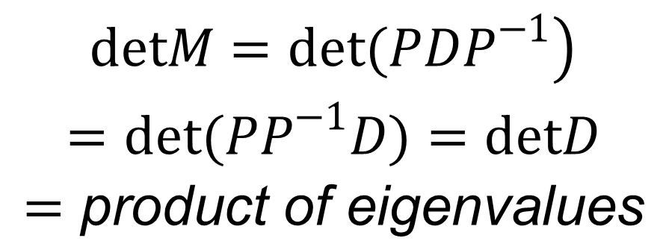
5.10 Trace of a Matrix
Remark:
$$\begin{matrix}\left.detM=det(PDP^{−1}\right) \\ =det(PP^{−1}D)=detD \\ =\text{product} \text{of} \text{eigenvalues}\end{matrix}$$
eigenvalues
DetM=(0.3)(1)=0.3
End
Chapter 5

Slide 105
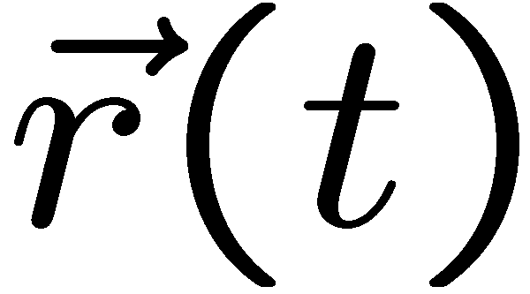
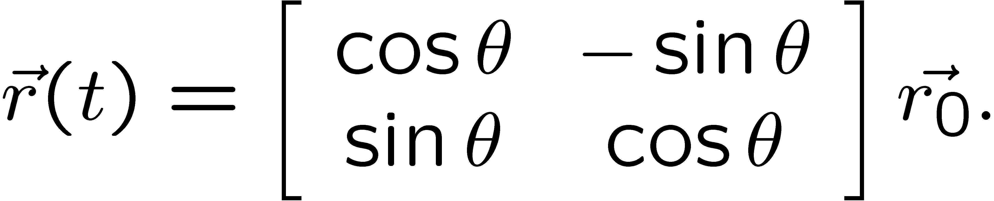
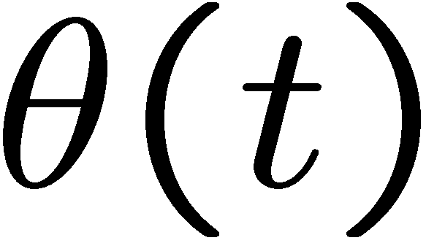
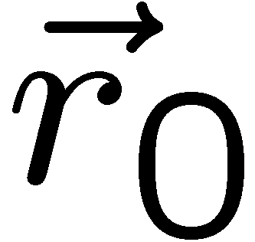
Appendix
object moving in a circle
Suppose an object is moving in a circle at constant angular speed ω . What is its acceleration?
θ depends on t

Slide 106
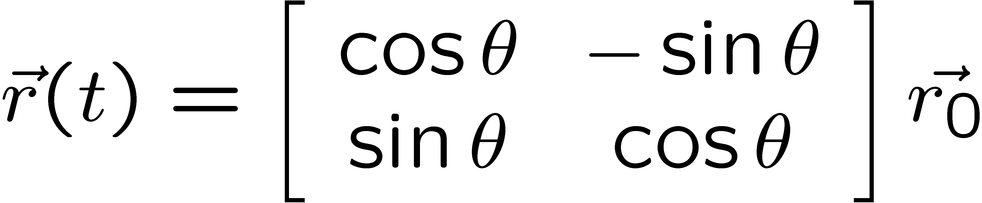
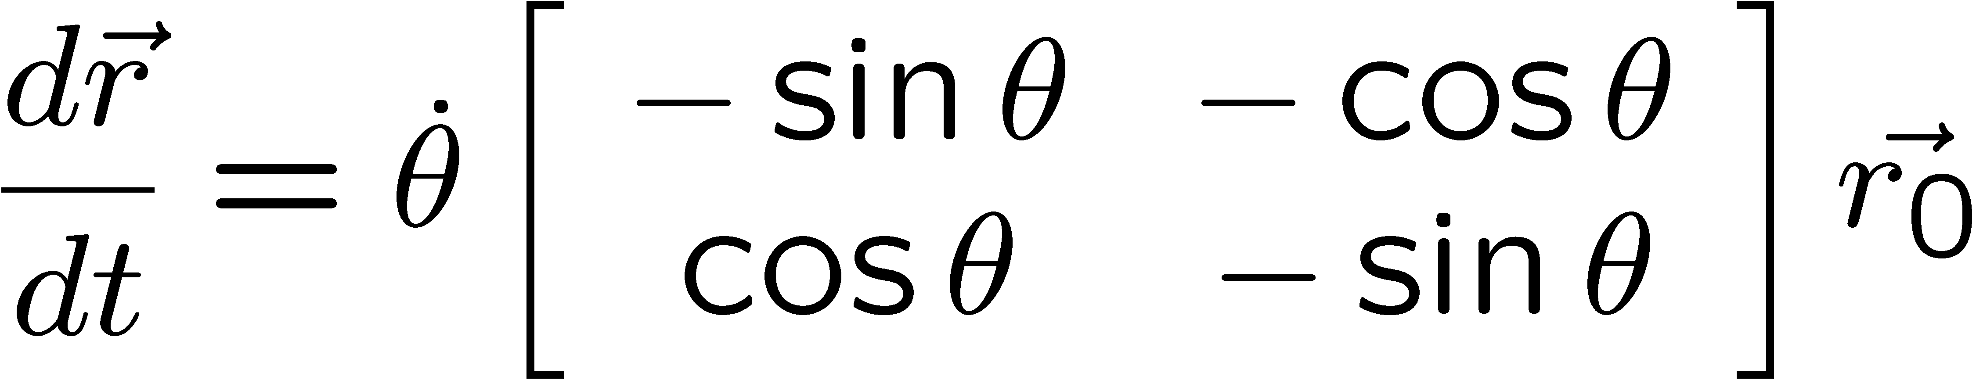

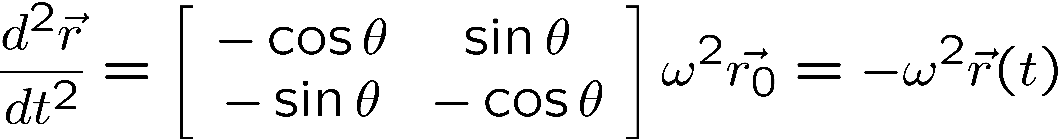
cont.
Appendix
ω is constant

Slide 107

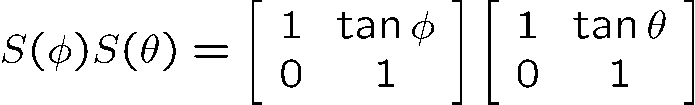
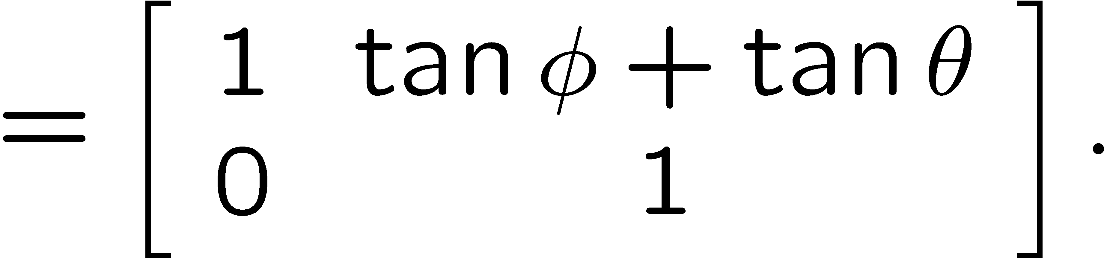
Composing two shears
Appendix
S: shear degrees parallel to x axis
S: shear degrees parallel to x axis
Still a shear but note that

Slide 108
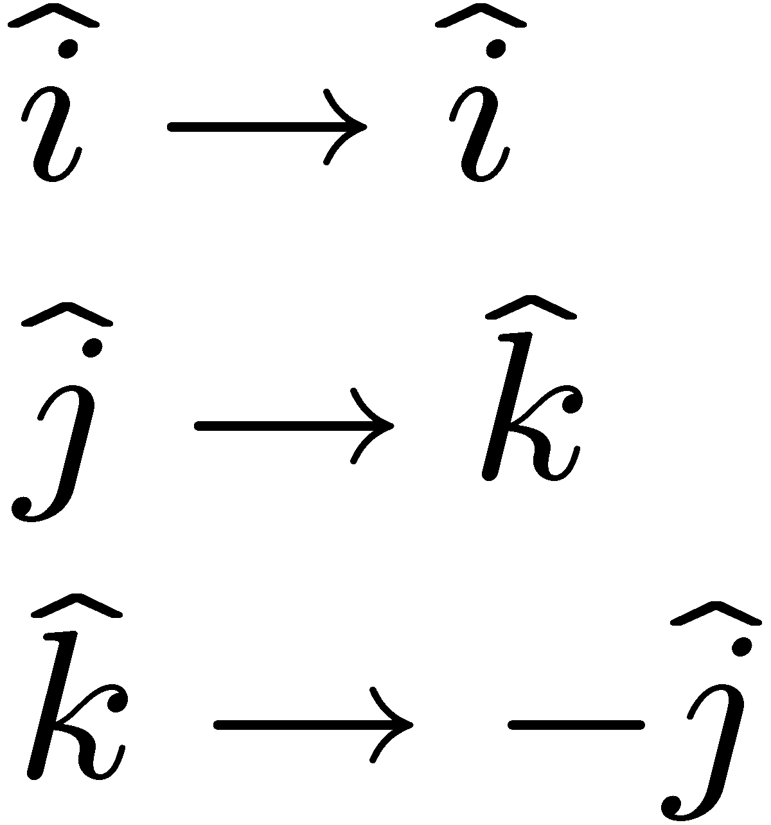
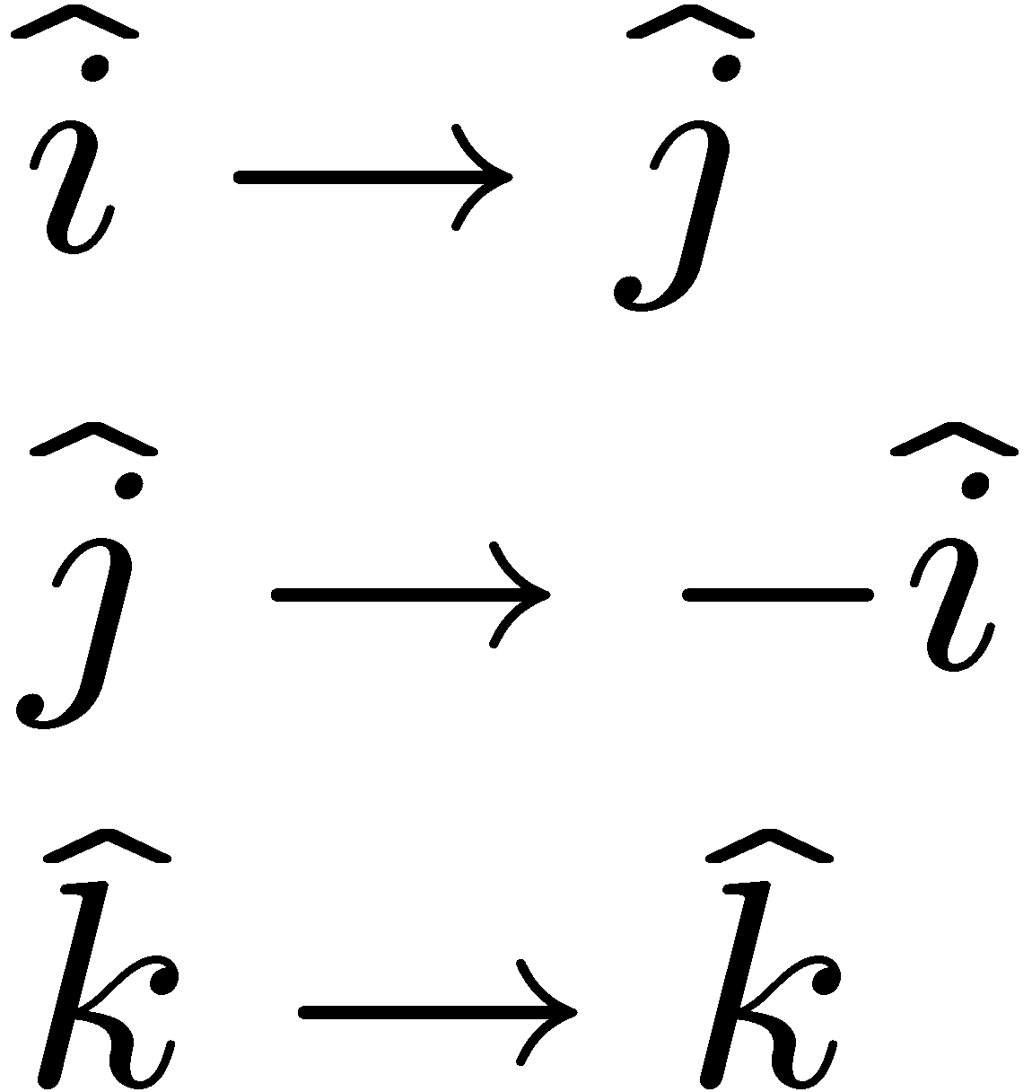
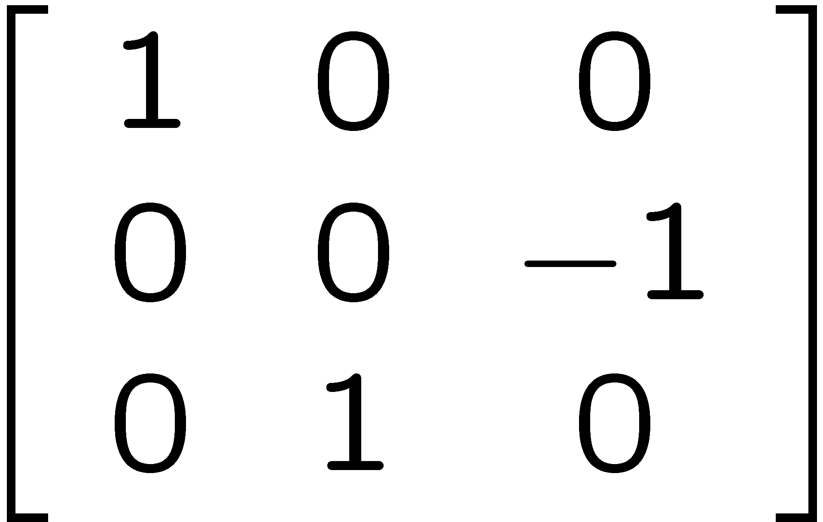
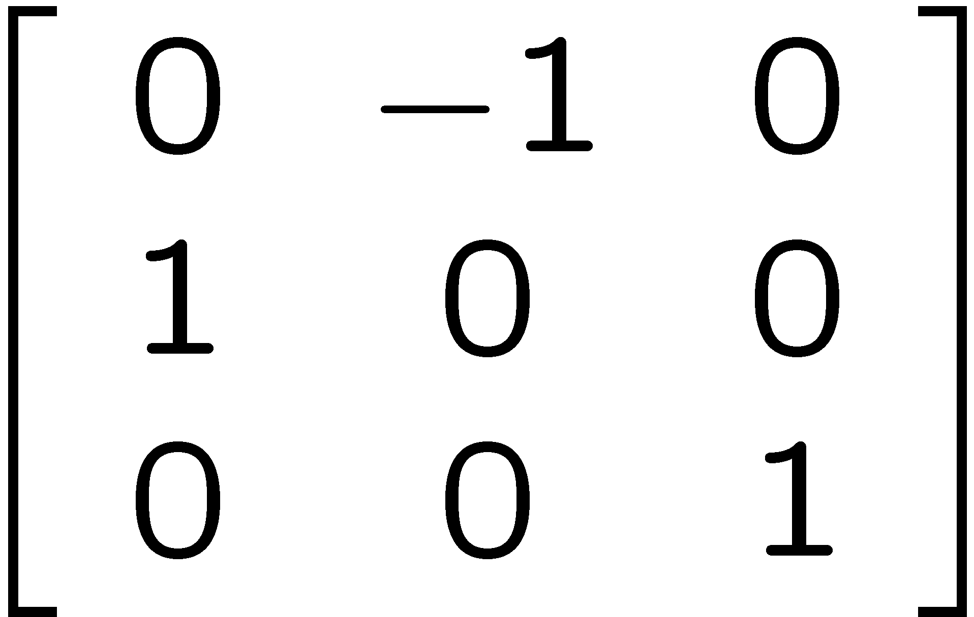
Rotation in 3D
Appendix
Rotate 90 degrees (anticlockwise) about z-axis
Rotate 90 degrees (anticlockwise) about x-axis
About z-axis
About x-axis

Slide 109
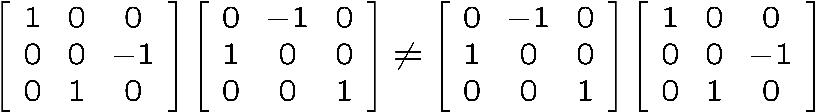
Cont.
Appendix
Rotate 90 degrees
(anticlockwise) about z-axis
Rotate 90 degrees
(anticlockwise) about x-axis

Slide 110






Determinant of Orthogonal Matrix
Appendix
Examples

Slide 111
exits
Appendix
iff
Hence
are parallel iff
not parallel iff
So if
not parallel
then
exits

Slide 112
Row operations to find inverse
Appendix
Refer to Textbook Section 3.3 for more details
Three row operations on a matrix
multiply a constant to a row
switch two rows
add a multiple of another row (see example)
Remark: 2nd method finding inverse see slide 46

Slide 113
Cont.
Appendix
Example
Let
A=
Suppose that we know that A has an inverse.
Now we shall do the following to get

Slide 114
Cont.
Appendix
First write
Try to get zero as many as possible
for the lower triangular part.

Slide 115
Cont.
Appendix
Now get 1 on diagonal
Now try to get
zero
as many as
possible
for the upper
triangular part.

Slide 116
Cont.
Appendix
When we reach this step,
we get
=

Slide 117
Cont.
Appendix
Consider linear system AX=B
where
A=
X=
B=
Now the inverse of A exists. Hence we have

Slide 118
Cont.
Appendix
Therefore
=
=
End
of
Chapter 5

